Slide 1
Nordic Climate Journalism and Green Conflicts
Inaugural NordJour launch - Journalism amid Climate Change
Stockholm 12.10. 2023
Andreas Ytterstad
andreasy@oslomet.no

Slide 2
AS if there were not enough conflicts integral to climate change already…
If only the media could treat it as a crisis
From «balance as bias» vis-a-vis denialism of the science to response denialism (Climate sceptics’ denying of the science is declining. Opposing the policies is the new tactic - Energy Post)
And from the Norwegian Jury…A rescue package for Oil and more lawsuits…

Slide 3
Yet parts of Nordic climate journalism do seem to step it up…
Public Broadcasting, like YLE
Emergence of new niche media
National newspapers, like Expressen, go for it (but fail?)
Examples of «transformative climate journalisms»
Perhaps even a numerical increase in Nordic newspapers…

Slide 4
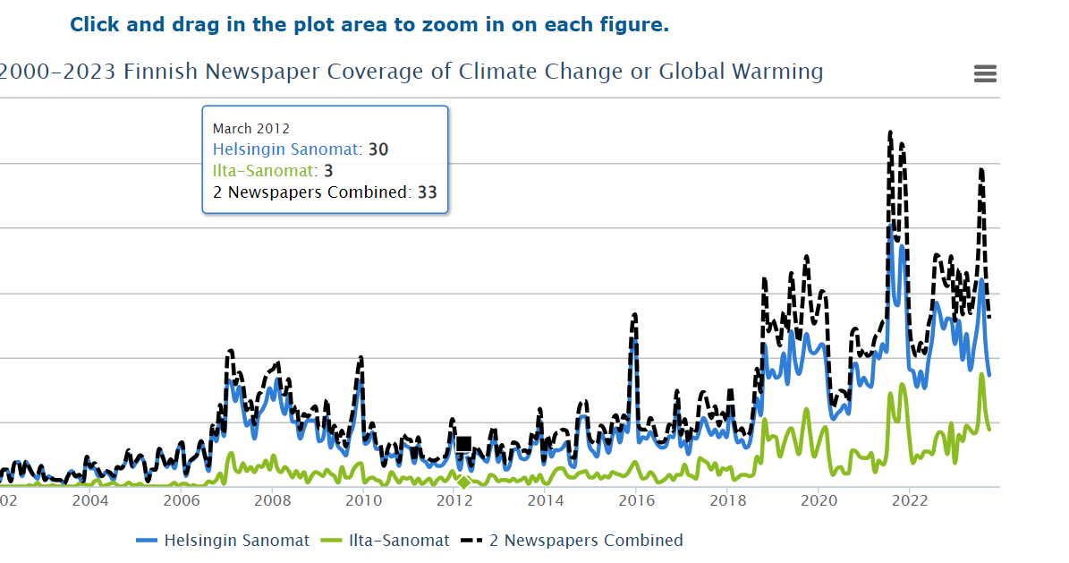

Slide 5
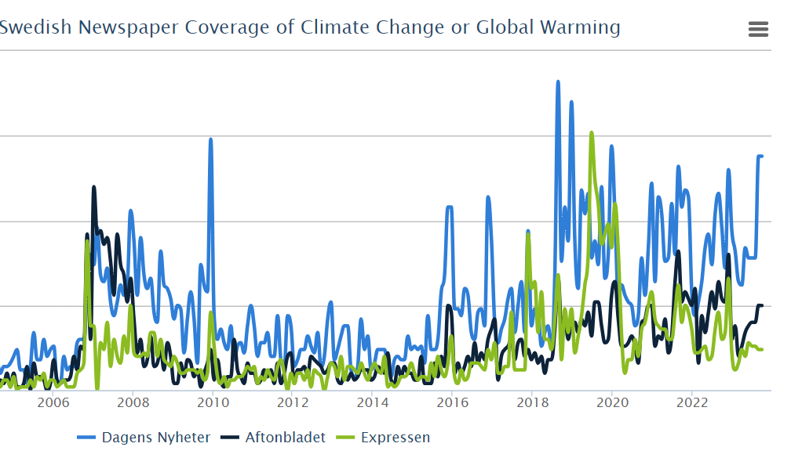

Slide 6
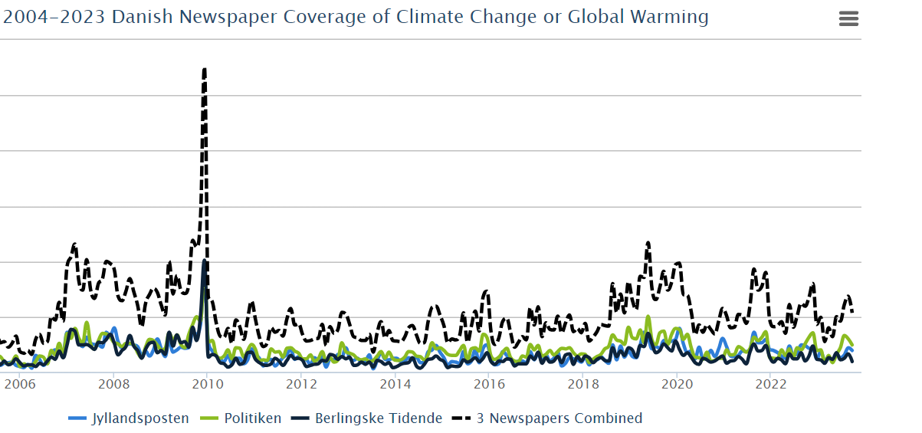

Slide 7
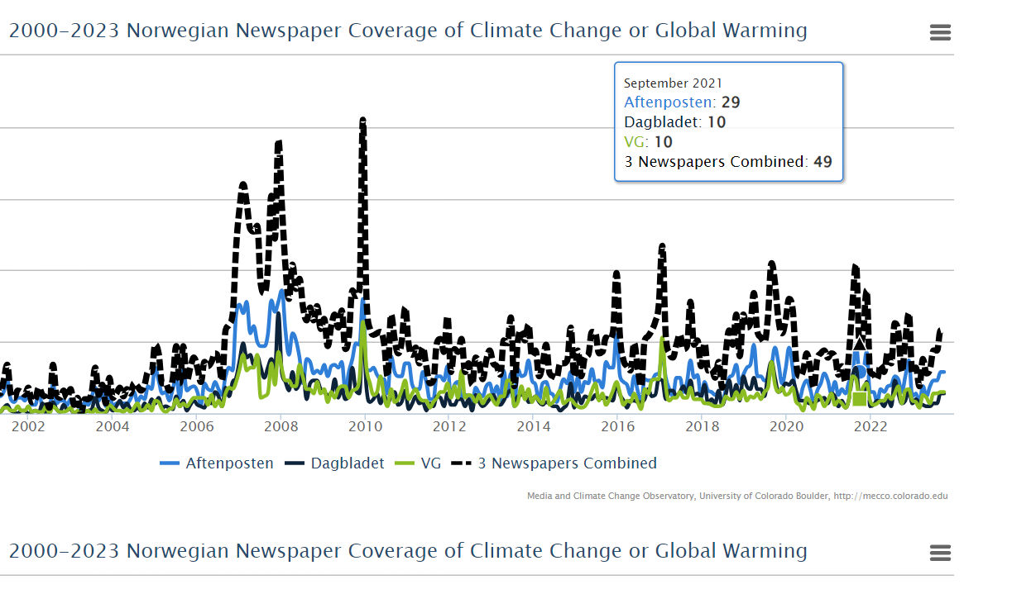

Slide 8
The emergence of the Norwegian «green shift» - climate as backyard
In 2015, “the green shift” was declared the “new word of the year” by the Language Council of Norway. A search in the retriever database of 364 Norwegian newspapers shows that in 2021, for the very first time, the number of entries under the search string green* shift* (11291) surpasses climate change*(8481).

Slide 9
The agency of the green shift – business interests or market logics
The notion of “climate risk”, pushed consistently in the climate journalism of Energi og klima, is an attempt to fuse what we have called “market demand time” with “climate emergency time This fusion of a dual rationale to act—prompted both by economic opportunity and scientific necessity—has emanated, and arguably become the dominant perspective within mainstream Norwegian climate journalism.” (Ytterstad and Bødker, 2021)

Slide 10
Framing climate futures: the media representations of climate and energy policies in Finnish broadcasting company news
Actors’ affiliations in articles related to the climate policy documents.

Slide 11
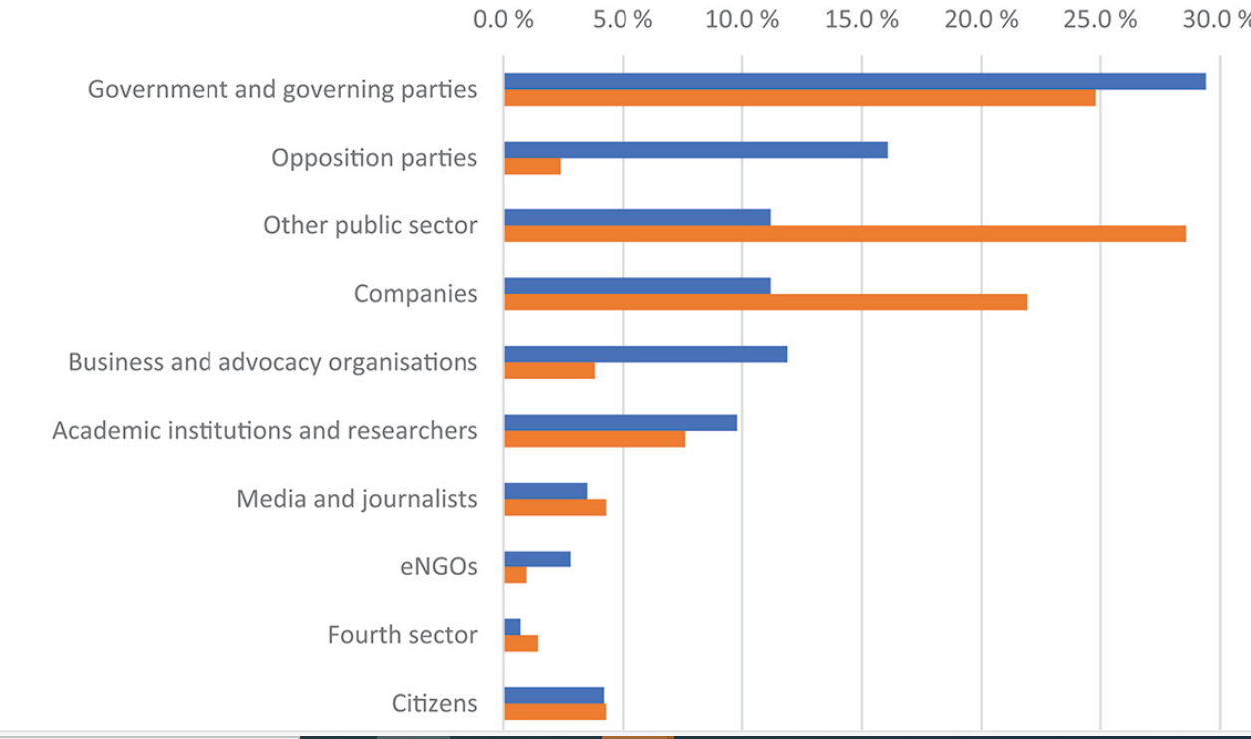

Slide 12
Nordforsk call for «green transitions» and democratic engagement
Journalistic engagements are vital “to ensure the envisioned transformation is perceived as legitimate, and that citizens have possibilities to be included and shape the narratives of transformation.”
Our focus on journalistic engagements in local sites of conflict, resonate heavily with the following sentence from the call: “Democratic involvement is crucial for legitimate and successful implementation of new, green initiatives. Lack of such engagement will likely cause delays, lead to initiatives being blocked by public protest, or even to the implementation of initiatives that can have disastrous effects on local societies. The importance of legitimate processes for decision making and permission can be overlooked in critical situations when political decisions are rushed.” By exploring on, and focusing on, the quality of local journalistic arenas in places where such “new green initiatives” take place, we respond to the need of good descriptions of “how projects and processes in Nordic and Baltic contexts have succeeded or failed in enabling a broader involvement of stakeholders and citizens.”.

Slide 13
Democratic engagement a prequisite for green transitions
As Corner and Clarke (2016, p. 5) write, “Public engagement is the foundation on which technological, political, and economic policies on energy and climate change are predicated[…]. Only when – at a societal level – the importance of the issue has been collectively internalized, can we expect climate policies to stand robustly against potentially hostile political winds.”
As Karen O´Brien insists, we will not stand a chance of a future with no more than 1.5 degrees global warming if we treat people as “objects to be changed.” We must instead recognize people as “agents of change” where “everyone is part of a system, and everyone has a sphere of influence.” (O’Brien, 2018, p. 158)

Slide 14
Green conflicts in a Nordic context- they are many and varied!
This book focuses specifically on policy mixes and wind power diffusion in four Nordic countries – Denmark, Finland, Norway and Sweden. Although these Nordic welfare states have much in common, they have adopted different wind power policies and experienced dissimilar diffusion trajectories.

Slide 15
But they can (re)surface any given Wednesday
From the Guardian
Yesterday…

Slide 16
Or Sunday…
Dagsrevyen – 1. oktober · Ble pågrepet her – NRK TV

Slide 17
Test-cases of journalism as an important democratic arena for green transitions, are local sites of conflict, both green conflicts and just transition conflicts
The sparsely populated Arctic North serves as a good example. Many of the ambitious climate policies of Norway, Sweden and Finland rely on green transition projects in the Arctic. On the one hand, such local sites of conflict consist of “new environmental controversies” – where the search for new minerals to power renewable energy, for example, can be framed as both solution and problem. On the other hand, we have “just transition” controversies related to all this “new extractivism” up North, and its consequences for depopulation, jobs, and Sami human rights and land rights.
Do stakeholders have a voice, and do they have a choice in green transition projects?

Slide 18
Climate* AND justice* in Norwegian Newspapers
(all sources, date May 23rd 2023)

Slide 19
Perhaps the Nordic model take justice for granted?
Explicit Just Transition arose historically as a Response to Neoliberalism in the USA
«in a coordinated capitalist country, like Sweden, in which many of the social welfare demands of explicity just transition are already policy» just transition policies «may be called implicit or embedded just transition» (Stevis 2023, p. 6)

Slide 20
Perhaps we should not: a short chronicle of a news story in 2024 foretold…

Slide 21
Conclusion, (as always) more research is needed
Given the mounting evidence of a changing climate and the fundamental ways in which green transitions reshape everyday lives and question deep-seated values — often linked to increasing conflicts between nationally-set goals of mitigation and citizen interests — we need reassessments of what it means to be engaged for both journalists and citizens
By analysing emergent ways in which this is happening within and related to journalism at the national, local/regional and the citizen level, this project produces new knowledge upon which transformative journalistic practices can be developed; and we do so, by working closely with public service institutions, local/regional media and citizen outlets in Norway, Sweden, Denmark, Finland and Lithuania.

