Slide 1
styrmedel för energi- och klimatmål
Charlotta Söderberg
Universitetslektor, Statsvetenskap
Luleå tekniska universitet
Läs mer: ltu.se/staff/c/chasod-1.81314

Slide 2
Idag
En liten bakgrund: varför är miljö, klimat och energi intressant för en statsvetare?
Miljöintegrering, och uppblossande konflikter, i bioenergipolitiken
Resurseffektiva energisamarbeten – vad driver dem?
Klimatlagen: vårt projekt och en första resultatredovisning

Slide 3
Varför är miljö, klimat och energi intressant för en statsvetare?

Slide 4
En vanlig fråga från natur- och t-sidan:
”Vi har ju berättat vad som behöver göras och vilka lösningar som finns på miljö-, klimat- och energiproblemen – varför händer det ingenting?”
Mitt svar: samhället är komplext, många motstridiga värden finns, politiker har bara en mandatperiod i taget (men vill bli omvalda) och styrmedel måste vara välriktade, långsiktiga och fungera.
Gemensamt för alla mina forskningsprojekt: hur kan man politiskt styra mot ett mer hållbart samhälle?

Slide 5

Environmental problems – travel across borders
Environmental problems are transnational and often multisectoral
Problems are global but solutions are local
”The private is political” – rational individual decisions lead to suboptimal collective results.
Environmental, Climate and Energy issues require international, multi-level and cross-sectoral cooperation

Slide 6
Brundtland commission:
“the integrated and interdependent nature of the new challenges and issues today contrasts sharply with the nature of the institutions that exist today. These institutions tend to be independent, fragmented, and working to relatively narrow mandates with closed decision processes. Those responsible for managing natural resources and protecting the environment are institutionally separated from those responsible for managing the economy. The real world of interlocked economic and ecological systems will not change; the policies and institutions must” (p. 310).
  ”Our Common Future” (1987)

Slide 7
Sustainable development
"Sustainable development is development that meets the needs of the present without compromising the ability of future generations to meet their own needs. It contains within it two key concepts:
the concept of needs, in particular the essential needs of the world's poor, to which overriding priority should be given; and
the idea of limitations imposed by the state of technology and social organization on the environment's ability to meet present and future needs.”
(”Our common future”, 1987)
Three dimensions of SD:
Economic (Growth, trade, production, aid , development)
Social (Poverty, gender equality, justice, health, participation)
Ecologic (Ecological resilience ecosystem protection)

Slide 8
Sustainability – who for?
Three dimensions of SD = goal conflicts
Antropocentrism: human needs most important
Ecocentrism: intrensic value of nature
Environmental policy integration (EU Treties)

Slide 9
Miljöintegrering, och uppblossande konflikter, i bioenergipolitiken

Slide 10
Figure 1. Salixplantering 1989 – 2002 i relation till anläggningsstödet.

Slide 11
Bioenergy expansion – a multi-level and multi-sector process
A multi-sector process:
Bioenergy is all types of energy generated from biofuels, which are derived from biomass (by-products from forestry and agriculture; municipal and industrial waste streams; field fuels). Biomass is thus produced in different sectors.
A multi-level process:
Bioenergy is of increasing importance within the EU: biomass important to achieve the goals of 27% renewable energy by 2030 and 10% renewable transport fuels by 2020.
Any future bioenergy expansion in the EU depends on both how the demand side (energy/climate change policy) and the supply side (agriculture, forestry and waste) of biomass develops.
Depends on policies and development on global, EU, national and sub-national levels.

Slide 12
Miljöintegrering i bioenergipolitiken
Behöver ofta hjälp från gemensamma problemuppfattningar mellan olika sektorer; associeras med sektorsspecifika problem: underlättar koordinering som i sin tur underlättar koherens (samstämmighet)
Styrs ofta uppifrån och ner: internationella och nationella policymål och åtgärder som implementeras på olika nivåer
Prioriteringarna ser olika ut i olika sektorer och på olika nivåer, men ökat fokus på miljö över tid och ökad samordning
Långsiktiga mål och konkreta åtgärder är viktiga för att uppnå reella resultat: enbart retoriska uttalanden på högre nivå räcker inte: uppföljning av vad som händer i praktiken och på lägre nivåer krävs för att inte politiska deklarationer ska förbli just uttalanden
(Söderberg, 2011: ”Environmental policy integration in bioenergy”)

Slide 13
Emerging conflicts: the global setting
The global biomass resource base will undergo a fundamental transformation in the coming decades as a result of the convergence of many driving forces. Agricultural and forest production systems must feed and shelter a growing world population and at the same time meet the demands for fuel, fibre, fertilizer and the many other types of goods and services that are derived from bio-based sources and conversion systems (Johnson and Virgin, 2010, p. 164)
Prognosis 2050: 51% world population growth; 91% increase in demand for transportation fuel.
At the same time, growing concern over GHG-emissions causing climate change and concern regarding energy security.
Together, these prospects and concerns have spurred the interest in bioenergy globally, as well as within the EU (70% of renewable energy consumption).

Slide 14
Conflicting views:
Conflicting views on the potential benefits of large scale bioenergy production:
Competition for forest biomass?
To what extent do potential environmental/socioeconomic benefits outweigh the risks/unintended consequences?
How to accomodate increased forest use with biodiversity protection (different EU policy goals)?
A multi-sector issue – forestry, agriculture, energy, transport: focus is different in different sectors!

Slide 15
Policy issues and conflicts | Dominant frames
 | Bioenergy for green growth | Bioenergy for energy security | Bioenergy for rural development | Bioenergy for climate
Availability of land and natural resources | Wood supply and mobilisation; pricing of wood energy may divert timber markets | Dependency on bioenergy import from developing countries; food vs. fuel supply | Food production vs. energy production; negative impacts on recreational values | Forests as carbon sinks threatened
Biodiversity protection | Intensive biomass production detrimental to biodiversity; protected forests threatened
Climate change | Intensive biomass production for biofuels may increase GHG emissions
Equity and sustainability | Socio-economic concerns both within Europe and in third world countries | Socio-economic concerns both within Europe and in third world countries | Entrepreneurship with sustainability concerns?; Livelihoods for forest-dependent communities particularly in developing countries threatened incl. indigenous peoples | Distribution of climate emission rights and responsibilities

Slide 16
Summary: policy conflicts/synergies
EU bioenergy policy potentially counteract EU targets regarding biodiversity, land use change and GHG-mitigation. What will be prioritised?
Also potential synergies between bioenergy and nature conservation (forest residues – less fire risk; grass cuttings – open landscape).
Impact on wood prices/import needs?
Forest plantations for biomass versus forests as carbon sinks and anti-deforestation/biodiversity?
Exploitation of poor regions to produce cheap biofuels for the rich – or beneficial for poor regions?

Slide 17
Prospects to overcome conflicts:
Optimism: The conflicts based in policy disagreement are likely to be reconciled. Different scientific understandings will produce new knowledge, shed new light on environmental consequences of bioenergy. Example: sustainability criteria for biofuels.
Pessimism: Evidence of fundamental conflicting values and interests – policy controversy – which are difficult to reconcile. Basic views on what values should have priority in societal development – and how rights/responsibilities should be shared in a global world.
(Söderberg and Eckerberg (2013). ”Rising policy conflicts between bioenergy and forestry” Forest Policy and Economics (33), pp. 112-119.
)

Slide 18
Resurseffektiva energisamarbeten: vad driver dem?

Slide 19
The sub-national level holds the key to the realisation of sustainability ambitions – this is where the real trade-offs are made and where biomass is produced!
What spurs sub-national renewable energy development?
Environmental agenda setting (EU – national): what is sustainable?
Project research funding available (EU – national): important for start-up of new technology development
Win-win strategies: local job creation and local growth main driving forces for municipalities – environmental arguments starts to matter when emphasised in EU/national policy.
Regional competence for recieving EU-funding
Policy entrepreneurs: important for connecting actors, finding win-win solutions and balancing renewable energy projects in line with global debate, EU/national funding opportunities and local needs (framing and reframing).

Slide 20
”Sweden…is covered with forest but there is only one Biofuel Region. In order to initate and maintain durable and sustainable renewable energy projects on the sub-national level, policy entrepreneurs capable of pointing towards local win-win solutions, with extensive personal networks…and capable of applying for EU and national funding are crucial” (Söderberg, 2014, p. 134)
Do not underestimate the role of environment!
Renewable energy projects initated on environmental grounds are more durable than renewable energy project initiated for other reasons (economic growth/supply security)
Environmentally interested persons in leading positions enter renewable energy projects with more realistic expectations and endure longer wihtin projects
Municipalities expecting explosive growth in jobs and economy are less durable in renewable energy projects
High-level political priorities provides the setting and guide sub-national actors in their actions!
But: sub-national level actors also have to make trade-offs between e.g. health care/education and renewable energy:→ need win-win arguments!

Slide 21
Resource efficient cities: Lessons for national and local actors
EU/state sets overarching frames and send important signals through policy, economic instruments, laws and regulations regarding the relevance of utilizing waste products and waste heat: this increases the possibilities to discover resource efficient energy solutions.
STATE: Create instruments that identifies resource efficient opportunities (e.g. municipal energy plans with demands on identifying and using rest products and waste heat)
Overview earlier instruments so that they are not skewed
Support waste heat collaborations through economic support to local investments solving the key problems with uneven demand and the need for reserve capacity.
LOCAL: sets the local framework and send important long term local signals and can address two key factors for establishing successful district heating collaborations: the uneven demand and the need for reserve capacity .
The municipality can:
Through municipal energy plans signal the political will to use waste heat
Through short decision-making paths ensure to help with local knowledge on preconditions and to solve key problems.
Local actors should specifically take care to have an open communication, ensure that local representatives are placed at the negotiating table, and use external consultants in agreement negotiations.
(Wårell, Söderberg, Söderholm, 2017)

Slide 22
Handling bioeconomy policy conflicts – a summary:
Global/EU/National level:
Priorities are necessary! If policy conflicts are unresolved on higher levels, they must be handled on lower levels
Be clear and consistent! Long-term, high-level policy signals spurs sub-national development
Money talks! Follow strategies up with economic instruments
Sub-national level:
Find win-win-strategies (environment-economy)
Get long-term commitment (on realistic grounds)
Build competence for EU-/national funding applications
Build regional networks

Slide 23
Klimatlagen: vårt projekt och en första resultatredovisning

Slide 24
Klimatlagar som ett verktyg för miljöpolicyintegrering – en komparativ studie
Simon Matti och Charlotta Söderberg, LTU (Formas)
Har de klimatlagar som införts i europeiska stater under det senaste decenniet varit fördelaktiga i arbetet med att begränsa klimatförändringarna? Om så, i vilken utsträckning och på vilka sätt? Baserat på ett analytiskt ramverk som fokuserar klimatpolicyintegrering i såväl politisk retorik som i politisk praktik, analyserar och jämför den här studien politisk utveckling och policyresultat i fyra europeiska stater efter implementering av nationella klimatlagar.
Syftet med projektet är att analysera om, hur, varför och under vilka omständigheter klimatlagar bidrar till att driva på arbetet med att begränsa klimatförändringar i praktiken. Genom att jämföra och kontrastera designen och effekterna av klimatlagar i Storbritannien, Danmark, Finland och Tyskland, och även dra paralleller till den svenska klimatlagen, kommer projektet att möjliggöra analyser av betydelsen av institutionell kontext och passformsproblematik för att uppnå positiva utfall. Studiens resultat kommer att bidra till en bättre teoretisk och empirisk förståelse av lagstiftning i allmänhet, och klimatlagar i synnerhet, som instrument för miljöintegrering och därigenom föra med sig viktiga lärdomar för politiker som planerar att införa lagstiftning för att driva på arbetet med att begränsa klimatförändringarna i industrialiserade demokratier.

Slide 25
Främjar klimatlagar klimatåtgärder?
Process, output, outcome
H₁: CCAs leads to substantial outcomes in terms of positive climate performance.
H₂: CCAs give raise to changes in policy rhetoric, by affecting actors’ policy learning.
H₃: CCAs positively affect climate performance by improving cross-sectoral coordination and strengthening the political prioritization of climate mitigation.
H₄: CCAs positively affect climate performance by forwarding the implementation of new policy tools and political programs.
H₅: Changes in policy rhetoric affect public trust in the government’s ambition and ability to mitigate climate change, and positively increases public support for climate policy measures.
H₆: The interplay between political context and design of the CCA condition its effect on climate performance.
Matti och Söderberg ”The prospect of climate change acts as a means for environmental policy integration”

Slide 26
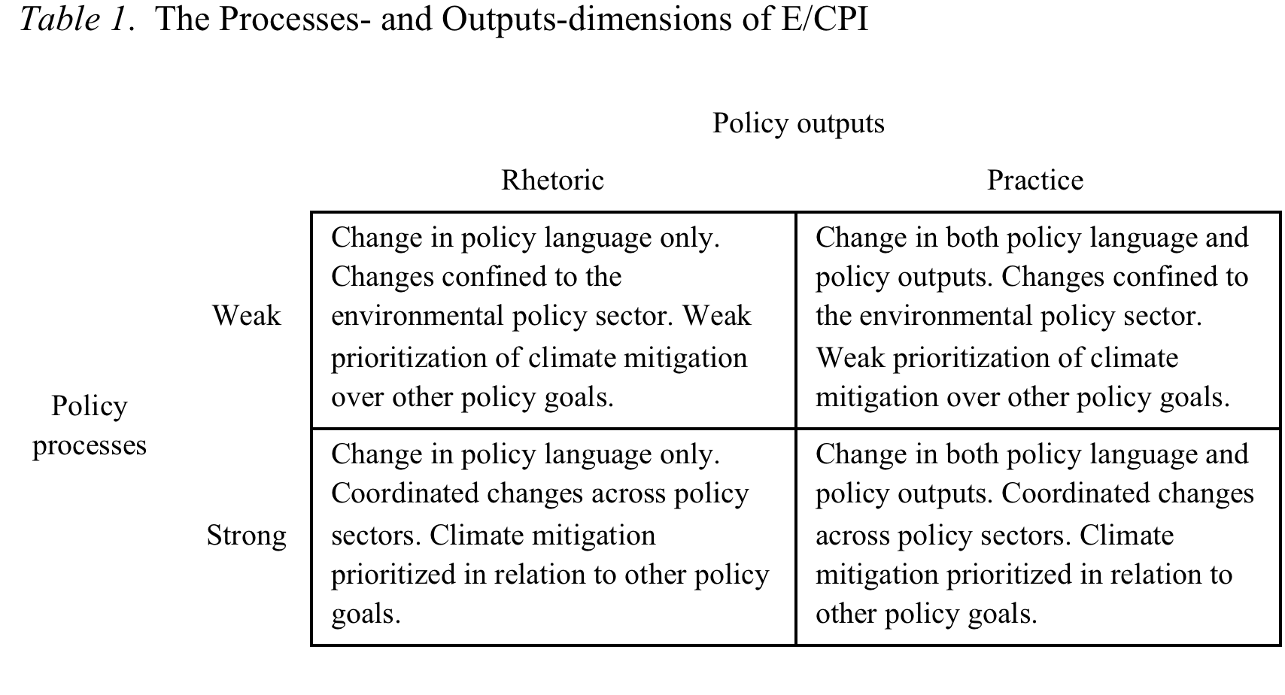

Slide 27
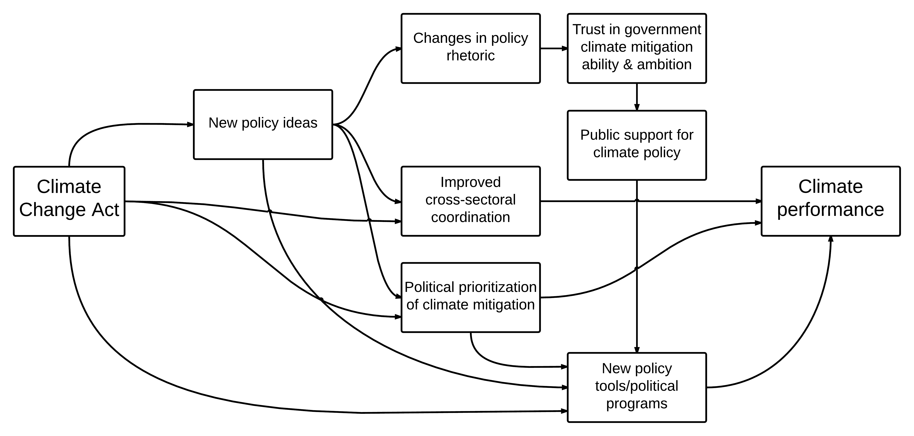
Figure 1. Proposed linkages between CCA, E/CPI, and substantial outcomes.

Slide 29
Läs mer:
Söderberg, C., Söderholm, K., och Wårell, L. (2017). Resurseffektiva städer. Framgångsrika lokala energisamarbeten. Energiforsk 2017:410. Energiforsk.
Matti, S. och Söderberg, C. (2016). The Prospect of Climate Acts as a Means for Environmental Policy Integration in Europe: A Comparative Study. Paper presented at the European Consortium for Political Research, Joint Sessions of Workshops, Workshop: Wither the Environment in Europe?, Pisa, 2016.
Söderberg, C. (2014). What drives sub-national bioenergy development? Exploring cross-level implications of environmental policy integration in EU and Swedish bioenergy policy. European Journal of Government and Economics, 3:2 2014, pp. 119-137.
Söderberg, C. och Eckerberg, K. (2013). Rising policy conflicts in Europe over bioenergy and forestry. Forest Policy and Economics (33), pp. 112-119.
Söderberg, C. (2011). Institutional conditions for multi-sector environmental policy integration in Swedish bioenergy policy. Environmental Politics (20)4, pp. 528-546.
Söderberg, C. (2011). Environmental Policy Integration in Bioenergy: Policy learning across sectors and levels? Doctoral Thesis, Umeå University.

